Slide 1

TRENDS IN THE BELGIAN REGISTRY OF COMPANIES
PRESENTED BY SOFIA MURILLO

Slide 2
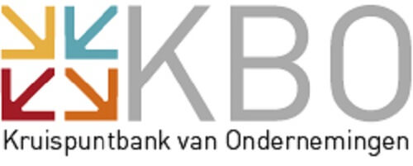
The Belgian Registry of Companies
...serves as the central database for all businesses and enterprises operating in Belgium, promoting transparency and simplifying administrative procedures
This presentation shows high level trends observed in the Belgian Registry of Companies and key years of higher growth

Slide 3
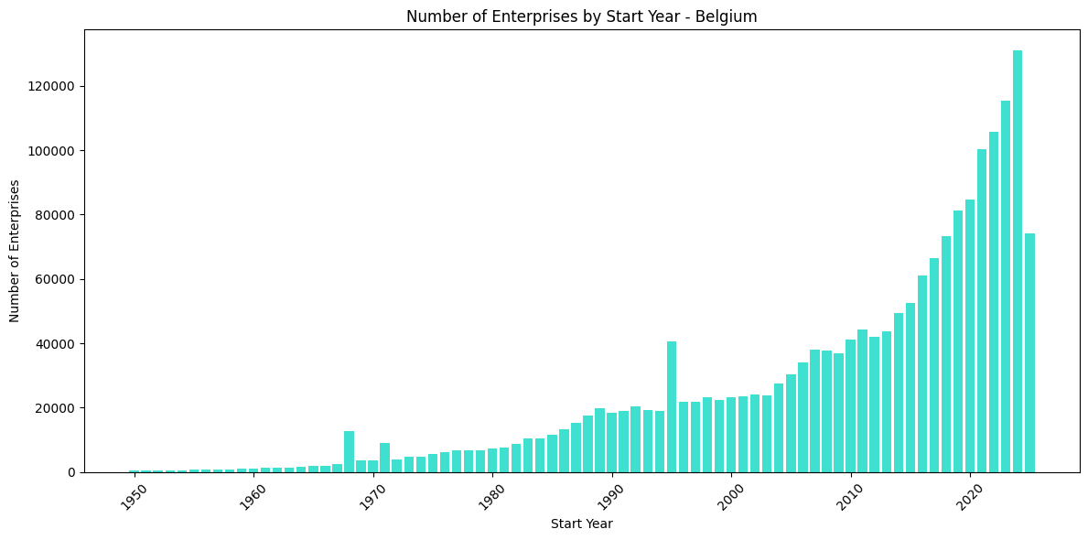
Steady, consistent, fast growth since the 60's
The Belgian market is considered dynamic
This is illustrated by the number of companies that are created every year: in 2024 nearly 128,000 companies were created
The European Innovation Scoreboard 2024 ranks Belgium in position 6, with performance at 123.6% of the EU average in 2024
Source: Analysis by Sofia Murillo of the KBO database; European Innovation Scoreboard 2024 – Country profile Belgium

Slide 4
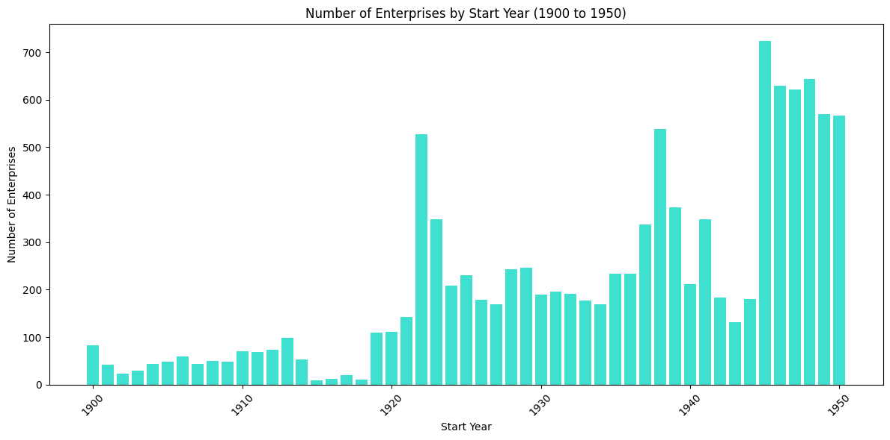
Impact of important events prior to 1950
Post WWII economic recovery*
Modernization of the Brussels - Charleroi channel in 1922
WWII
WWI
* Of all the European countries directly involved in WWII, Belgium was the first to restore its economy. With a limited claim to the funds made available by the US in 1947 through the European Recovery Plan, it would take only one year for Belgium to recover to its pre-war economic activity
Source: Analysis by Sofia Murillo of the KBO database, https://www.nato.int/cps/en/natohq/declassified_162358.htm

Slide 5
Since 1950, 2 years stand out in terms of number of companies created
1968: While this was a year of social and political unrest, the events spurred positive economic developments through labor reforms, educational restructuring, and increased trade opportunities
1995
1968
1995: In 1995, Belgium experienced an economic upturn driven by increased domestic demand, particularly in business fixed investment, following a period of slightly negative growth
Source: Analysis by Sofia Murillo of the KBO database; OECD Economic Surveys

Slide 6
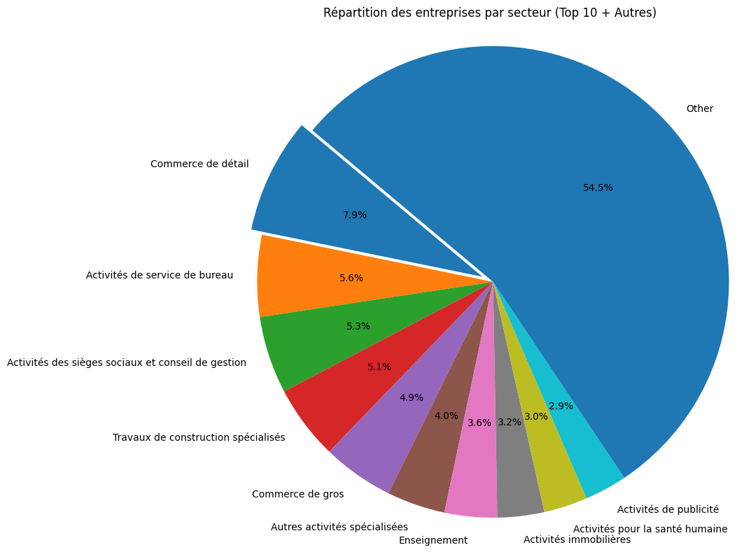
Currently 10 industries account for 45% of the total number of companies
8%
Commerce de detail
5.6%
Activités de service de bureau
5.3%
Activités des sièges sociaux et conseil de gestion
Source: Analysis by Sofia Murillo of the KBO database

Slide 7
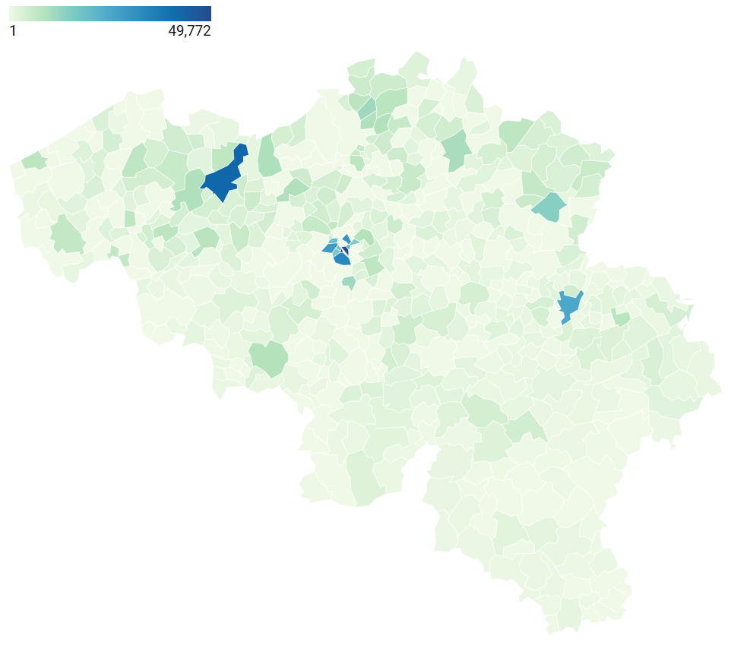



3 Postal codes stand out for number of companies: Brussels, Ixelles and Ghent
Brussels:
57,820 companies
Ixelles:
49,772 companies
Ghent:
42,218 companies
Source: Analysis by Sofia Murillo of the KBO database

Slide 8
Thank you very much!
PRESENTED BY SOFIA MURILLO

